Slide 1
HISTORICAL DEVELOPMENT OF MACHINE LEARNING
Ashok Dahal

Slide 2
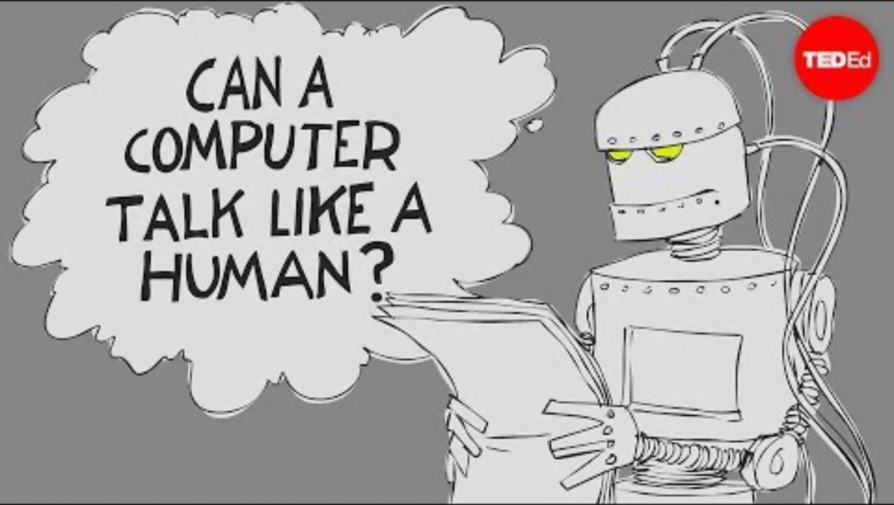

Slide 3
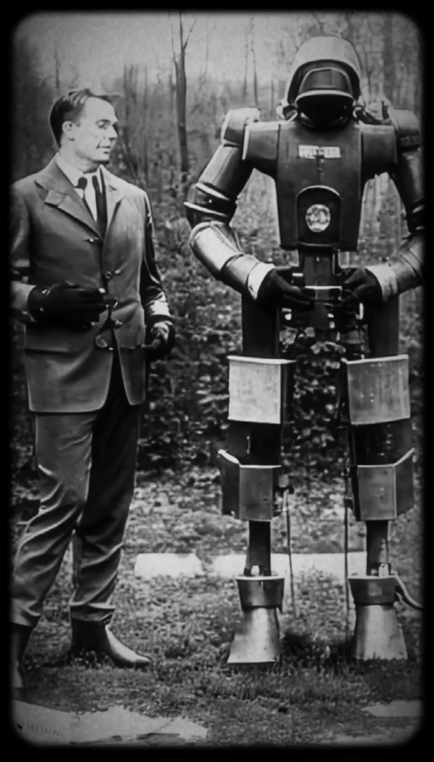
AI

Slide 4
The beginnings
WWII
Alan Turing and Marvin Minsky set the foundation of ML
1950s
Turing Test
A human can’t distinguish between machine and human-based responses
1958
Frank Rosenblatt father of the Perceptron algorithm
It is a linear classifier for binary tasks, like "cat" or "not a cat”
It has an input layer with weighted connections to a single output neuron
It adjusts weights during training to minimize prediction errors
Foundational for advanced neural networks and deep learning

Slide 5
The beginnings
WWII
Alan Turing and Marvin Minsky set the foundation of ML
1950s
Turing Test
A human can’t distinguish between machine and human-based responses
1958
Frank Rosenblatt father of the Perceptron algorithm
It is a linear classifier for binary tasks, like "cat" or "not a cat”
It has an input layer with weighted connections to a single output neuron
It adjusts weights during training to minimize prediction errors
Foundational for advanced neural networks and deep learning

Slide 6
The beginnings
WWII
Alan Turing and Marvin Minsky set the foundation of ML
1950s
Turing Test
A human can’t distinguish between machine and human-based responses
1958
Frank Rosenblatt father of the Perceptron algorithm
It is a linear classifier for binary tasks, like "cat" or "not a cat”
It has an input layer with weighted connections to a single output neuron
It adjusts weights during training to minimize prediction errors
Foundational for advanced neural networks and deep learning

Slide 7
The beginnings
WWII
Alan Turing and Marvin Minsky set the foundation of ML
1950s
Turing Test
A human can’t distinguish between machine and human-based responses
1958
Frank Rosenblatt father of the Perceptron algorithm
It is a linear classifier for binary tasks, like "cat" or "not a cat”
It has an input layer with weighted connections to a single output neuron
It adjusts weights during training to minimize prediction errors
Foundational for advanced neural networks and deep learning

Slide 8
The beginnings
WWII
Alan Turing and Marvin Minsky set the foundation of ML
1950s
Turing Test
A human can’t distinguish between machine and human-based responses
1958
Frank Rosenblatt father of the Perceptron algorithm
It is a linear classifier for binary tasks, like "cat" or "not a cat”
It has an input layer with weighted connections to a single output neuron
It adjusts weights during training to minimize prediction errors
Foundational for advanced neural networks and deep learning

Slide 9
The beginnings
WWII
Alan Turing and Marvin Minsky set the foundation of ML
1950s
Turing Test
A human can’t distinguish between machine and human-based responses
1958
Frank Rosenblatt father of the Perceptron algorithm
It is a linear classifier for binary tasks, like "cat" or "not a cat”
It has an input layer with weighted connections to a single output neuron
It adjusts weights during training to minimize prediction errors
Foundational for advanced neural networks and deep learning

Slide 10
The beginnings
WWII
Alan Turing and Marvin Minsky set the foundation of ML
1950s
Turing Test
A human can’t distinguish between machine and human-based responses
1958
Frank Rosenblatt father of the Perceptron algorithm
It is a linear classifier for binary tasks, like "cat" or "not a cat”
It has an input layer with weighted connections to a single output neuron
It adjusts weights during training to minimize prediction errors
Foundational for advanced neural networks and deep learning

Slide 11
The beginnings
WWII
Alan Turing and Marvin Minsky set the foundation of ML
1950s
Turing Test
A human can’t distinguish between machine and human-based responses
1958
Frank Rosenblatt father of the Perceptron algorithm
It is a linear classifier for binary tasks, like "cat" or "not a cat”
It has an input layer with weighted connections to a single output neuron
It adjusts weights during training to minimize prediction errors
Foundational for advanced neural networks and deep learning

Slide 12
The growth era
The 1980s
Breakthroughs in neural network research
Development and refinement of foundational algorithms (e.g., backpropagation)
New neural network architectures (e.g., multi-layer perceptrons, convolutional neural networks, recurrent neural networks)
Other ML techniques gained popularity (e.g. decision trees, support vector machines, genetic algorithms)
Initial real-world applications of ML (e.g. finance, medicine, engineering)

Slide 13
The growth era
The 1980s
Breakthroughs in neural network research
Development and refinement of foundational algorithms (e.g., backpropagation)
New neural network architectures (e.g., multi-layer perceptrons, convolutional neural networks, recurrent neural networks)
Other ML techniques gained popularity (e.g. decision trees, support vector machines, genetic algorithms)
Initial real-world applications of ML (e.g. finance, medicine, engineering)

Slide 14
The growth era
The 1980s
Breakthroughs in neural network research
Development and refinement of foundational algorithms (e.g., backpropagation)
New neural network architectures (e.g., multi-layer perceptrons, convolutional neural networks, recurrent neural networks)
Other ML techniques gained popularity (e.g. decision trees, support vector machines, genetic algorithms)
Initial real-world applications of ML (e.g. finance, medicine, engineering)

Slide 15
The growth era
The 1980s
Breakthroughs in neural network research
Development and refinement of foundational algorithms (e.g., backpropagation)
New neural network architectures (e.g., multi-layer perceptrons, convolutional neural networks, recurrent neural networks)
Other ML techniques gained popularity (e.g. decision trees, support vector machines, genetic algorithms)
Initial real-world applications of ML (e.g. finance, medicine, engineering)

Slide 16
The growth era
The 1980s
Breakthroughs in neural network research
Development and refinement of foundational algorithms (e.g., backpropagation)
New neural network architectures (e.g., multi-layer perceptrons, convolutional neural networks, recurrent neural networks)
Other ML techniques gained popularity (e.g. decision trees, support vector machines, genetic algorithms)
Initial real-world applications of ML (e.g. finance, medicine, engineering)

Slide 17
The present days
ML is rapidly advancing due to better computation, data, and algorithms
Deep learning, with multi-layered neural networks, is driving significant breakthroughs
It has transformed fields like computer vision, language processing, and speech recognition
Research continues to push deep learning's capabilities in AI

Slide 18
The present days
ML is rapidly advancing due to better computation, data, and algorithms
Deep learning, with multi-layered neural networks, is driving significant breakthroughs
It has transformed fields like computer vision, language processing, and speech recognition
Research continues to push deep learning's capabilities in AI

Slide 19
The present days
ML is rapidly advancing due to better computation, data, and algorithms
Deep learning, with multi-layered neural networks, is driving significant breakthroughs
It has transformed fields like computer vision, language processing, and speech recognition
Research continues to push deep learning's capabilities in AI

Slide 20
The present days
ML is rapidly advancing due to better computation, data, and algorithms
Deep learning, with multi-layered neural networks, is driving significant breakthroughs
It has transformed fields like computer vision, language processing, and speech recognition
Research continues to push deep learning's capabilities in AI

Slide 21
The present days
ML in everyday life
ML is increasingly embedded in everyday technologies, transforming our interactions with the world
E.g., personalized recommendations, virtual assistants, predictive maintenance, and healthcare diagnostics
The democratization of machine learning tools enables widespread innovation and creativity across various fields
Rapid growth brings challenges like ethics, bias, and the need for transparency, requiring collaboration to ensure responsible AI development

Slide 22
The present days
ML in everyday life
ML is increasingly embedded in everyday technologies, transforming our interactions with the world
E.g., personalized recommendations, virtual assistants, predictive maintenance, and healthcare diagnostics
The democratization of machine learning tools enables widespread innovation and creativity across various fields
Rapid growth brings challenges like ethics, bias, and the need for transparency, requiring collaboration to ensure responsible AI development

Slide 23
The present days
ML in everyday life
ML is increasingly embedded in everyday technologies, transforming our interactions with the world
E.g., personalized recommendations, virtual assistants, predictive maintenance, and healthcare diagnostics
The democratization of machine learning tools enables widespread innovation and creativity across various fields
Rapid growth brings challenges like ethics, bias, and the need for transparency, requiring collaboration to ensure responsible AI development

Slide 24
The present days
ML in everyday life
ML is increasingly embedded in everyday technologies, transforming our interactions with the world
E.g., personalized recommendations, virtual assistants, predictive maintenance, and healthcare diagnostics
The democratization of machine learning tools enables widespread innovation and creativity across various fields
Rapid growth brings challenges like ethics, bias, and the need for transparency, requiring collaboration to ensure responsible AI development

Slide 25
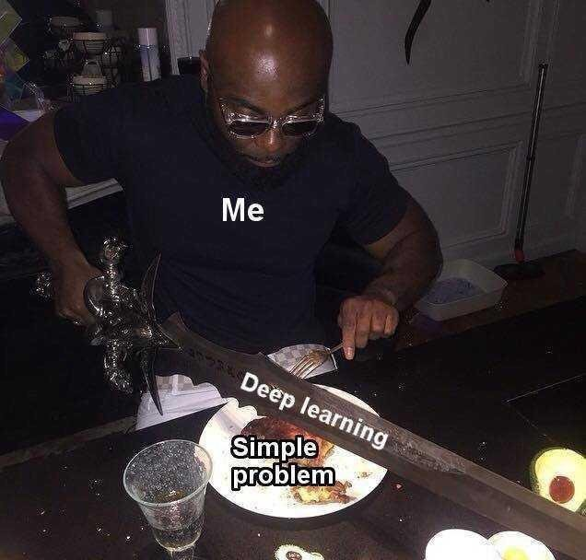
AI

Slide 26
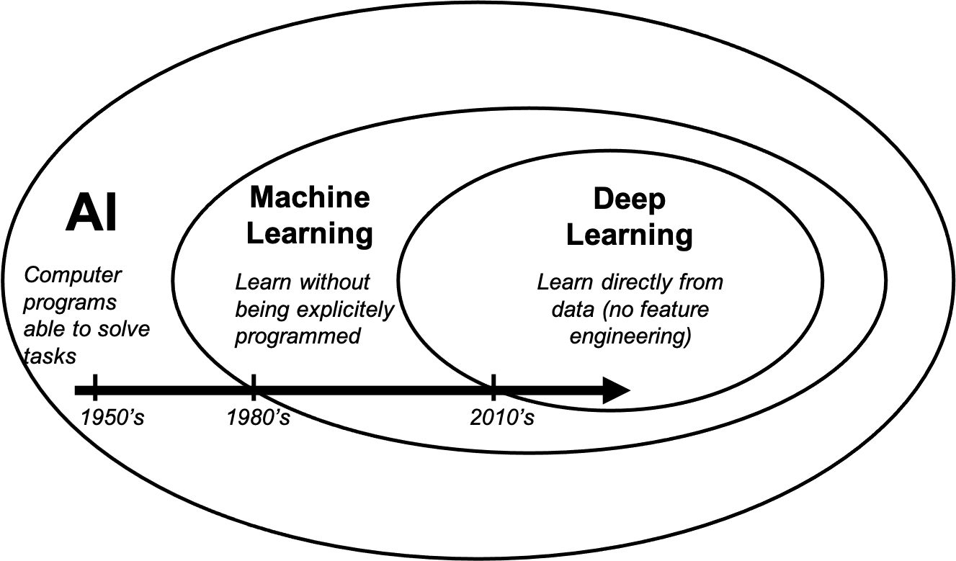
Credit: Matteo Ravasi et al, KAUST

Slide 27
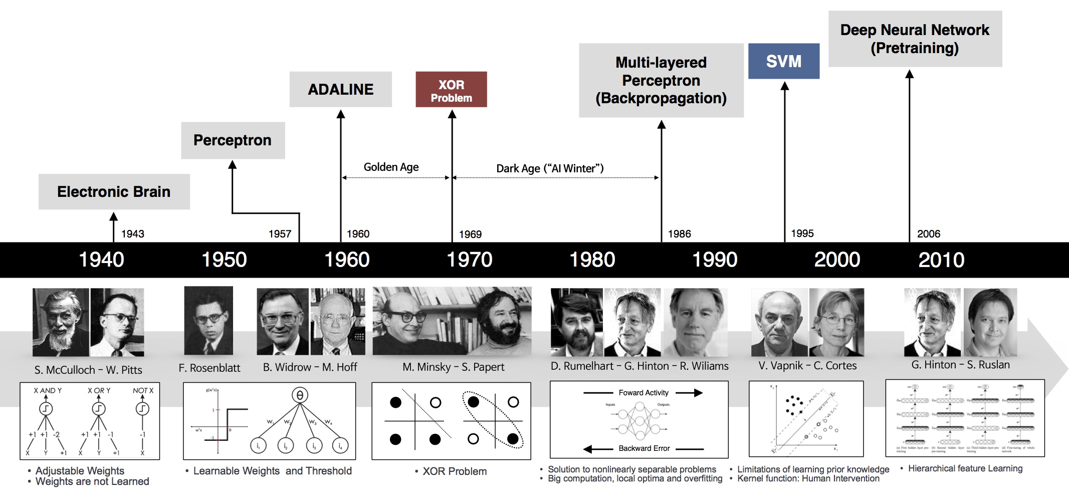
Credit: BeamLab and unkown source.

Slide 28
Jargon
That you must know
Supervised Learning
Unsupervised Learning
Semi-supervised Learning

Slide 29
Jargon
That you must know
Structured data (tables..)
Unstructured data (video, images..)

